Slide 1
Nervous System Part I Review
HMS 2014-2015

Slide 2
???
The process by which an organism’s internal environment is kept stable in spite of changes in the external environment

Slide 3
homeostasis
The process by which an organism’s internal environment is kept stable in spite of changes in the external environment

Slide 4
???
The basic unit of structure and function in all living things is a …

Slide 5
cell
The basic unit of structure and function in all living things is a …

Slide 6
???
A structure composed of different kinds of tissue
Heart, lungs, brain

Slide 7
organs
A structure composed of different kinds of tissue
Heart, lungs, brain

Slide 8
???
A group of similar cells that perform the same function

Slide 9
tissue
A group of similar cells that perform the same function

Slide 10
???
A group of organs that work together to perform a major function
Circulatory, respiratory, digestive

Slide 11
Organ system
A group of organs that work together to perform a major function
Circulatory, respiratory, digestive

Slide 12
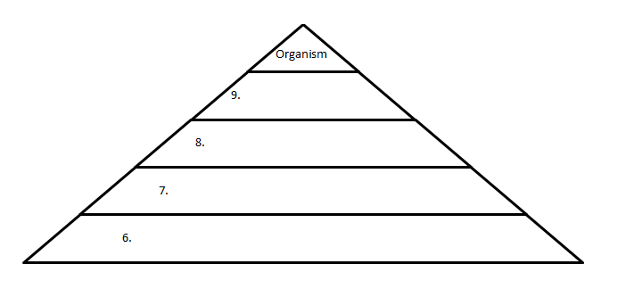
Most complex
???
Least complex

Slide 13
Most complex
???
cells
Least complex

Slide 14
Most complex
???
tissues
cells
Least complex

Slide 15
Most complex
???
organ
tissues
cells
Least complex

Slide 16
Most complex
Organ system
organ
tissues
cells
Least complex

Slide 17
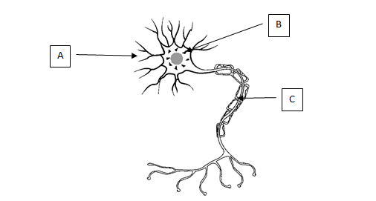
What is part A?

Slide 18
A=Dendrites

Slide 19
A=Dendrites
What do dendrites do?

Slide 20
A=Dendrites
Dendrites carry nerve impulses toward the cell body

Slide 21
What is Part B?

Slide 22
B=Cell Body

Slide 23
B=Cell Body
What does a neuron cell body do?

Slide 24
B=Cell Body
The cell body contains the nucleus

Slide 25
What is Part C?

Slide 26
C=Axon

Slide 27
C=Axon
What does an axon do?

Slide 28
C=Axon
Axons carries nerve impulses away from the cell body

Slide 29
???
Which type of neuron carries impulse from the brain/spinal cord (CNS) to muscle or gland

Slide 30
Motor neuron
Which type of neuron carries impulse from the brain/spinal cord (CNS) to muscle or gland

Slide 31
???
This type of neuron is found in the brain/spinal cord
Processes messages

Slide 32
interneuron
This type of neuron is found in the brain/spinal cord
Processes messages

Slide 33
???
This type of neuron carries impulses towards the brain/spinal cord (CNS)

Slide 34
Sensory neuron
This type of neuron carries impulses towards the brain/spinal cord (CNS)

Slide 35
???
How does a nerve impulse travel between neurons (from neuron to neuron)

Slide 36
Chemical impulse
How does a nerve impulse travel between neurons (from neuron to neuron)

Slide 37
What are the 3 functions of the nervous system?
1
2
3

Slide 38
What are the 3 functions of the nervous system?
1 _______ information
2 _______ to information
3 maintains ___________

Slide 39
What are the 3 functions of the nervous system?
1 receives information
2 responds to information
3 maintains homeostasis

Slide 40
???
A specialized cell of the nervous system that sends and receives information

Slide 41
neuron
A specialized cell of the nervous system that sends and receives information

Slide 42
???
These messages are transmitted from neuron to neuron

Slide 43
impulses
These messages are transmitted from neuron to neuron

Slide 44
???
This change or signal in the environment makes an organism react

Slide 45
stimulus
This change or signal in the environment makes an organism react

Slide 46
What is the correct order an impulse travels on a neuron
______________ → __________________ → _________________

Slide 47
What is the correct order an impulse travels on a neuron
dendrite → cell body → axon

Slide 48
???
The small space between neurons

Slide 49
synapse
The small space between neurons

Slide 50
???
Another name for a nerve cell

Slide 51
neuron
Another name for a nerve cell

Slide 52
???
A reaction or reflex

Slide 53
response
A reaction or reflex

